Slide 1
Travel Insurance Claim Predictor
Hackathon Presentation

Slide 2
Problem Statement
To predict if the claim request of a travel insurance is genuine or fake.
Potential Business Problem : With so many claims on daily basis it is difficult to study the authenticity of claims manually . Thus a automated system is needed to predict If a claim should be approved or not
Notes:
Can we include some examples here?

Slide 3
Why solve this problem?
We are solving this problem so that a genuine claim should not be rejected and a false claim should not be approved
Stakeholders:
CFO
Legal department

Slide 4
Data
We have information of roughly 50k consumer claims . There are around 11 features and 1 target variable.
Feature Name | Type
Agency Type | Object | It is either airline or travel agency
Distribution Channel | Object | It is either online or offline
Destination | Object | What was the destination of the travel.
Net Sales | float64 | What was the net sale while purchasing this insurance
Target variable here is Claim which is either 0 or 1 mentioning if the claim has been approved or not.

Slide 5
Evaluation metric
Since this is highly imbalanced data, accuracy is not the right measure for the performace of our model.
In this case we are going to consider Precision and Recall as the best measure for the performance of the model.

Slide 6
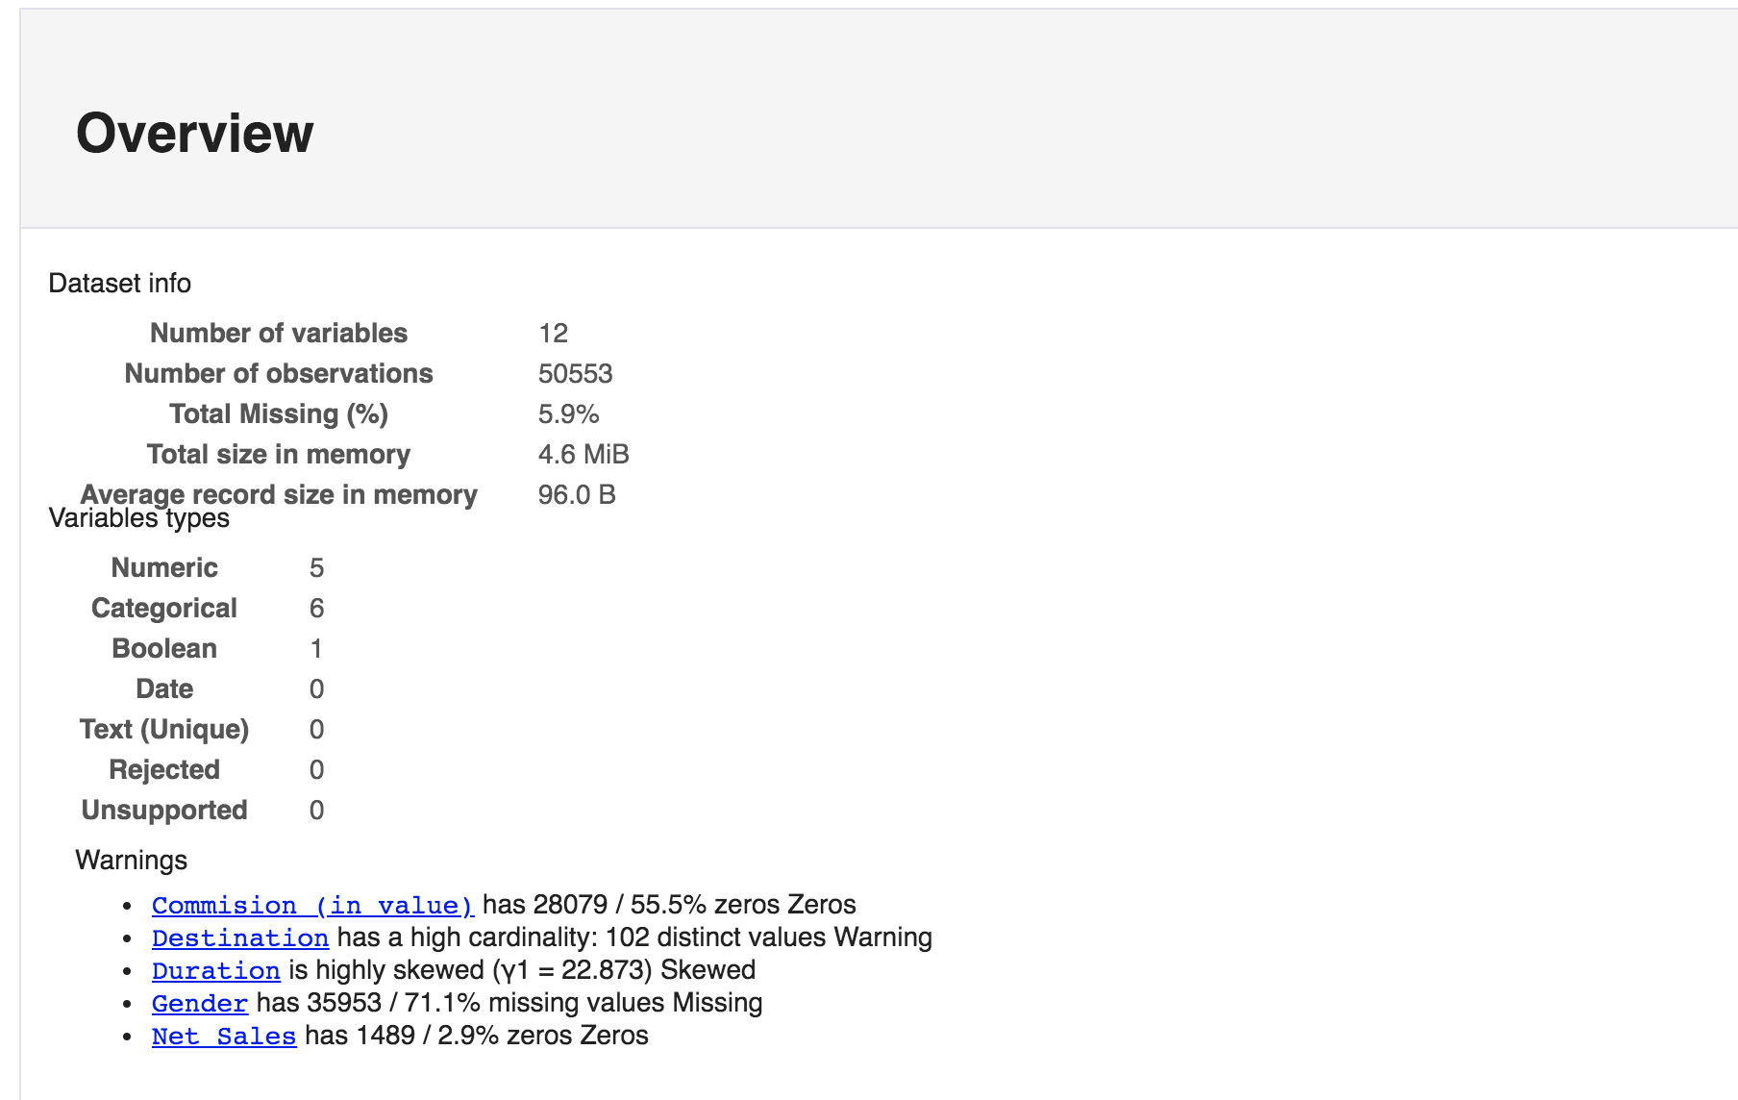
Exploratory Data Analysis

Slide 7
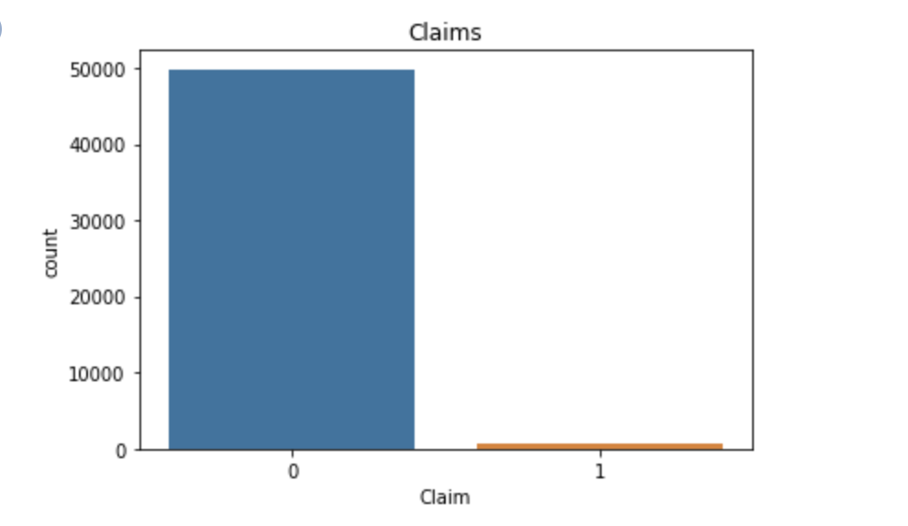
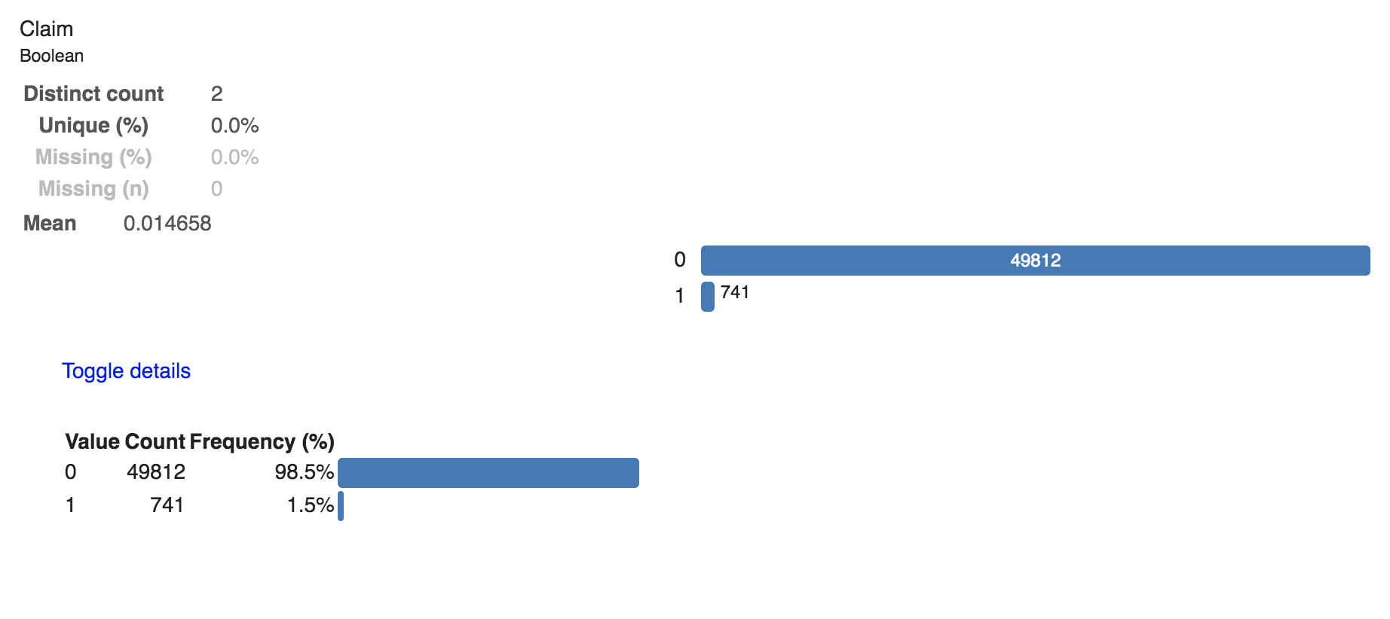
Exploratory Data Analysis- Target variable

Slide 8
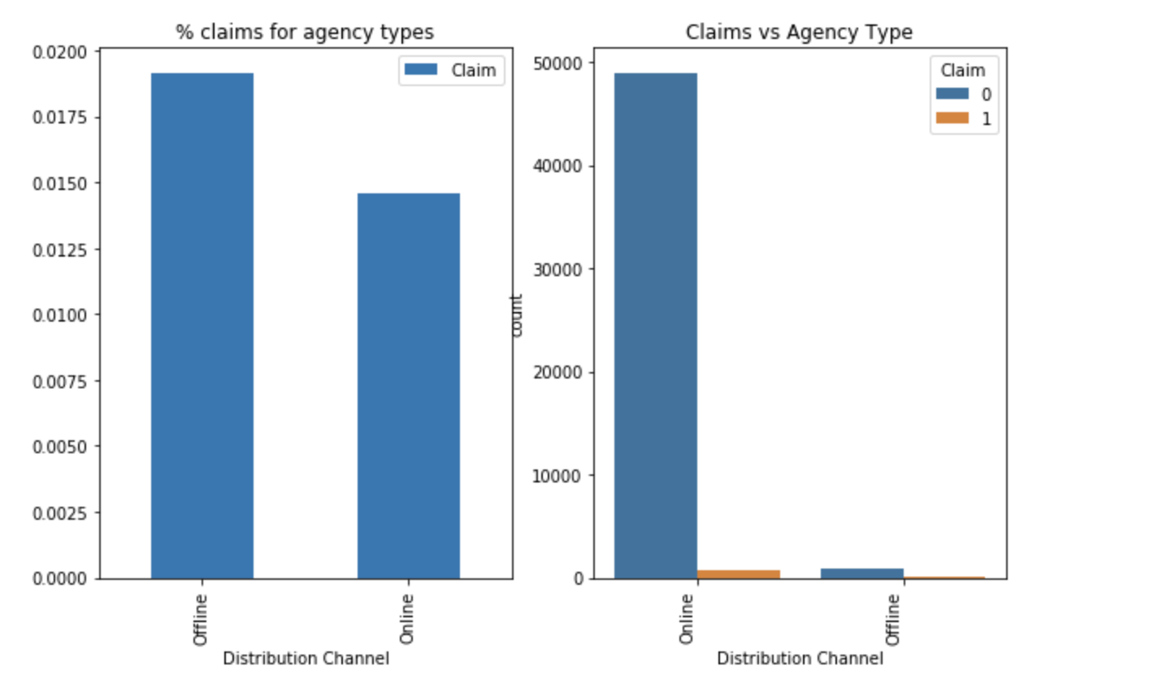
Exploratory Data Analysis- Categorial Variable – Agency type
Agency type has two values : offline and Online.
We can see that offline sales claim holds a very small value as compared to online

Slide 9
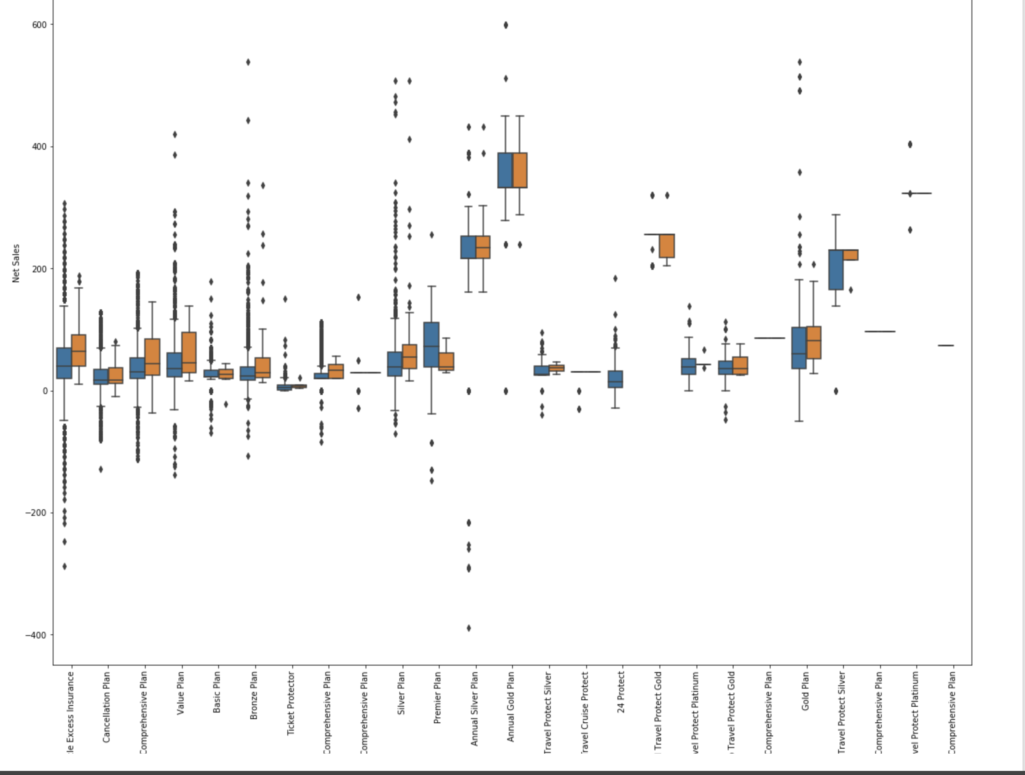
Exploratory Data Analysis- Continuous Variable – Commission, Net Sales
This is a boxplot for net sales vs various products.
We can see some outliers but relevance can be studied later

Slide 10
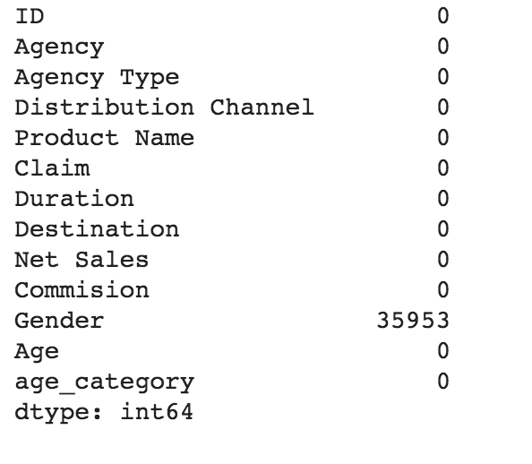
Pipeline – Dropping Gender
Since in this null check analysis, we can see that Gender has more than 50% null values. Thus it holds no relevance and can bee dropped

Slide 11
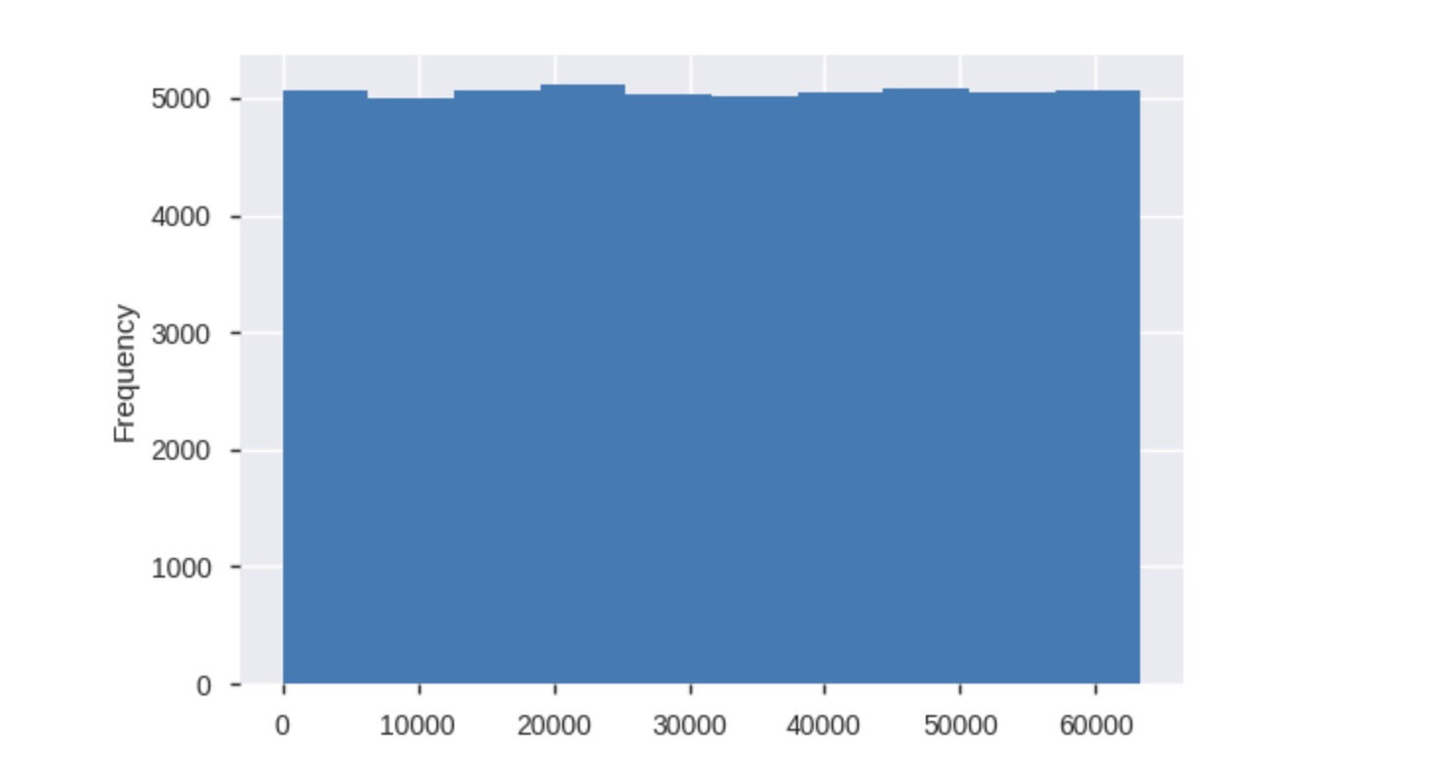
Pipeline – Dropping ID
Since the distribution plot of ID shows uniform distribution, we should drop ID feature as well

Slide 12
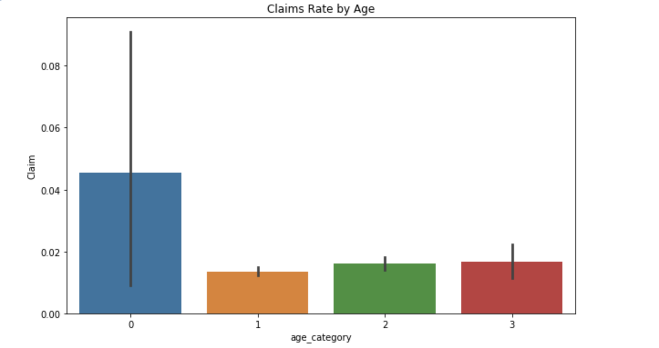
Pipeline – Categorizing Age
Since Age feature has so many values almost all unique do for better understanding we have divided age into categories.

Slide 13
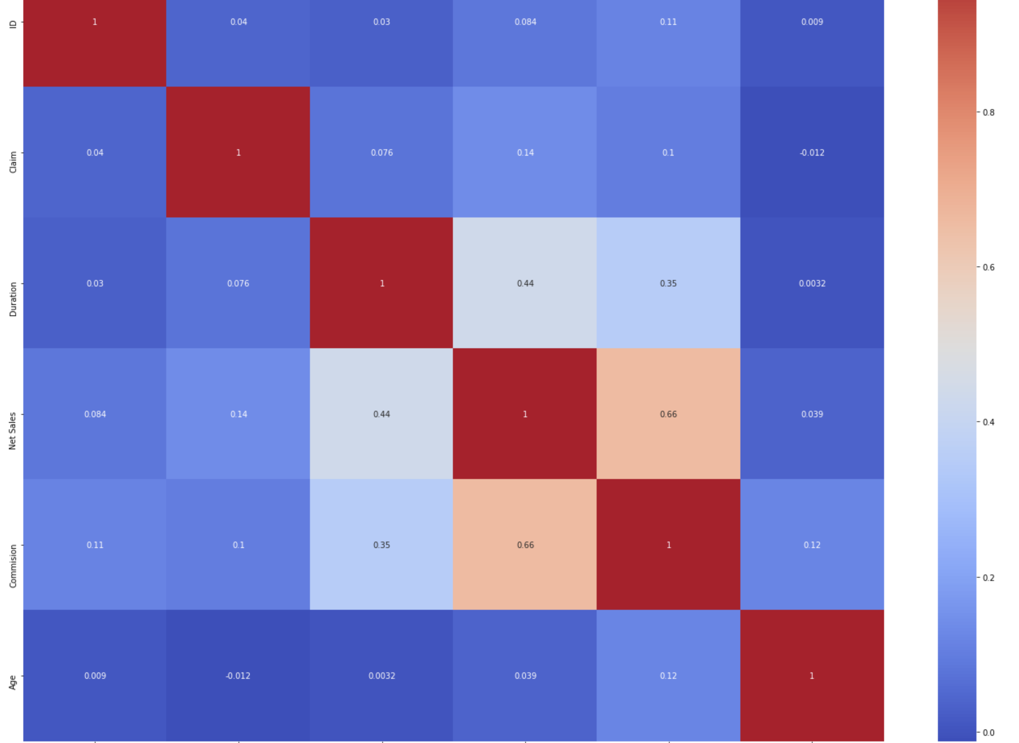
Pipeline – Correlation
Using this heat map, we can see that most correlated features are net sales and commission but they are not that much correlated that they can be dropped.

Slide 14
Models and Approaches
Since the dataset is so highly imbalanced that after running our Machine Learning models on it, it gave almost 0% precision and recall which was quite heartbreaking.
We performed under sampling for balancing the data set and used the following models to predict our target variable.
Logistic regression
Random Forest
SVM

Slide 15
Model Tuning
One Hot Encoding :
Since most of the features are categorial, we used one hot encoding to transform the data
PCA:
Since destination variable had high cardinality, the features size increased to 156. We used PCA for dimensionality reduction and chose 130 features.
Undersampling:
Since the data set is highly imbalanced, we did undersampling and made data with 50% positive claims data and 50% negative claims data.

Slide 16
Evaluation & Results
Model | Precision | Recall
Logistic regression | 0.82 | 0.75
Random Forest | 0.74 | 0.69
SVM | 0.79 | 0.74

Slide 17
Next Steps
If we had more time we would have:
1. Done Oversampling since under sampling loses lot of data.
2. Hyper parameter tuning.

